Slide 1
Netflix 2017 Stock Profile
Jessica Cao

Slide 2
Visualizations
Distribution of NFLX stock prices in 2017
NFLX predicted vs. actual earnings in 2017
NFLX stock and revenue comparison in past four quarters
NFLX vs. DOW J in 2017
Visualizer: Jessica Cao
Used Matplotlib, Pandas, and Seaborn Python Libraries

Slide 3
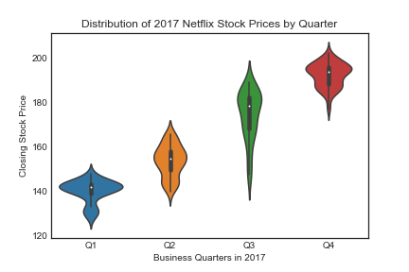
Shows the steady increase of Netflix’s stock price in 2017 with varying length of spreads.

Slide 4
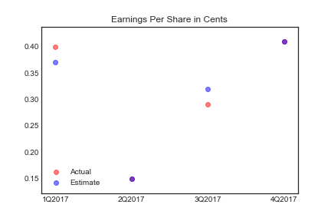
In Q2 and Q4 of 2017, the estimated and actual earnings per Netflix share were
equivalent.

Slide 5
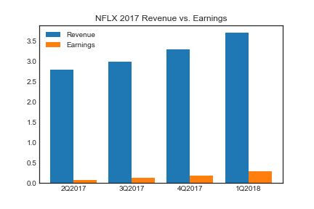
Both the revenue and earnings of Netflix in 2017 steadily increased, with earnings being
about 10% of the revenue.

Slide 6
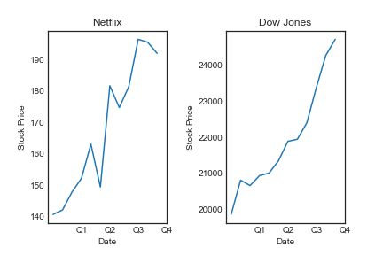
Though both Netflix and the Dow showed increasing trends, Netflix was far more volatile. As expected, Dow Jones’ stock price is about 150 times more than Netflix’s.

